Slide 1
The concentration of in situ ¹⁰Be in fluvial sediments as a tool for deciphering 6 My of Greenland Ice Sheet history from a marine sediment core
PROGRESS REPORT
Alice Nelson
October 11th, 2012
Photo: Josh Brown

Slide 2
Talk Outline
Research Goals
Cosmogenic Background
Hypotheses
Data sources
Fieldwork
Lab work
Initial Results and Interpretations
Timeline

Slide 3
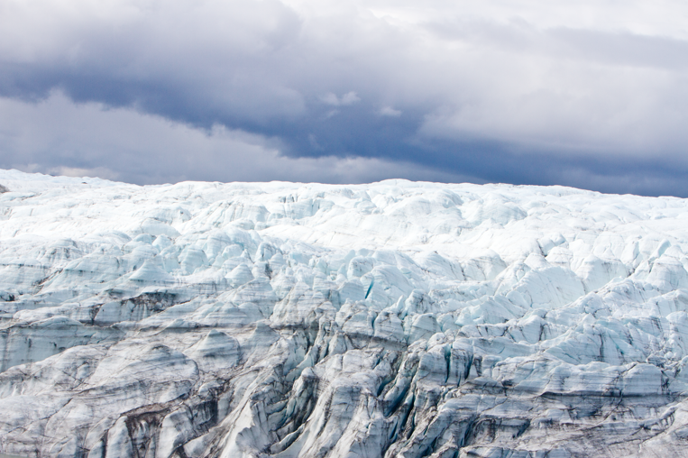
How has extent of the Greenland Ice Sheet (GIS) changed over the last 6 million years?
Big Picture Question
Photo: Josh Brown

Slide 4
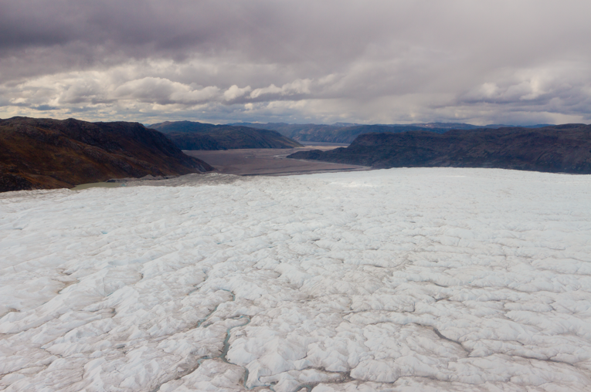
Research Goals
1. What is the ¹⁰Be concentration of the exposed landscape?
2. What is the ¹⁰Be concentration in sediments? 3. How does sediment erode, accumulate and move through the landscape?
3. What is the long term history of the Greenland Ice Sheet?
Photo: Josh Brown

Slide 5
Cosmogenic Background
¹⁰Be is produced in near surface rocks and sediments because of terrestrial exposure to cosmic rays
Production Rate:
3.98 g⁻¹ a⁻¹
¹⁰Be is not produced because of shielding by ice

Slide 6
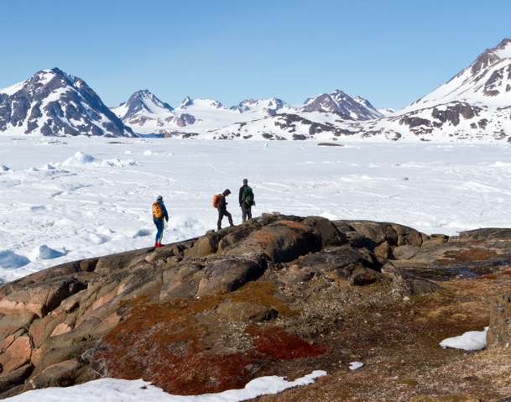
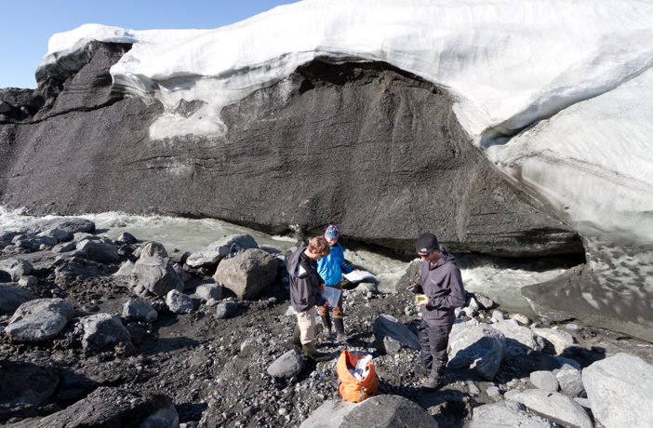
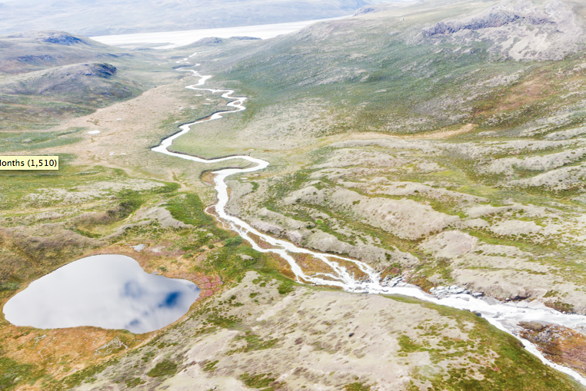
Hypothesis
I expect the concentration of ¹⁰Be in ocean core
sediments to fluctuate over time because of changes in:
A.
duration and extent of landscape exposure
B.
rate of regolith erosion
C.
duration of sediment storage within the landscape and timing of sediment transport to the ocean
Photos: Josh Brown

Slide 7
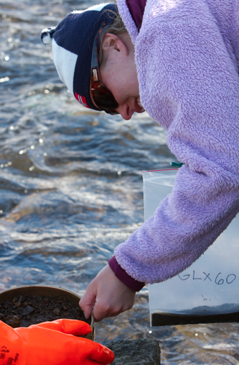
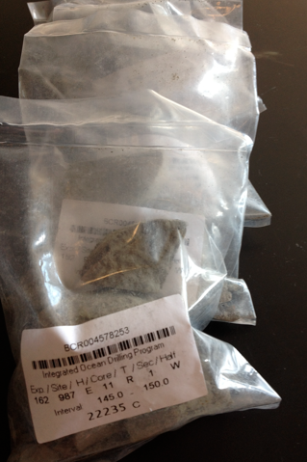
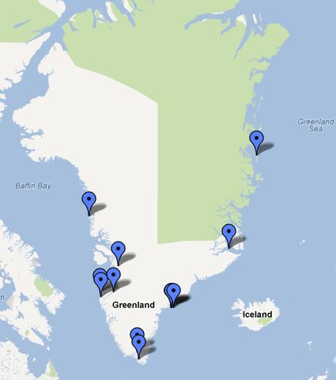
3 Sources of ¹⁰Be Data
Josh Brown
Field Samples
n=102
Ocean Core Samples
n=30
Previously Published
n=176

Slide 8
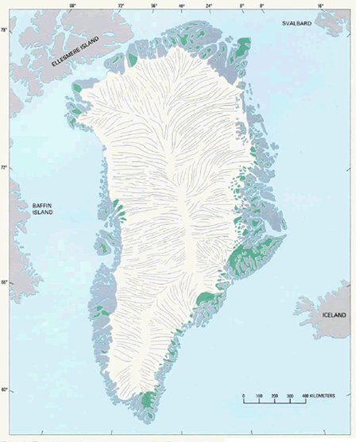
Field Work
Kangerlussuaq
Tasiilaq
918
Narsarsuaq

Slide 9
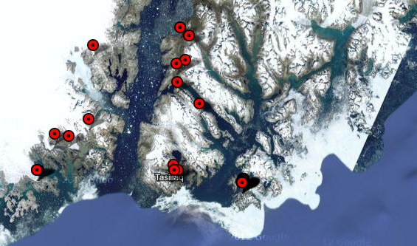
Field Work - Tasiilaq

Slide 10
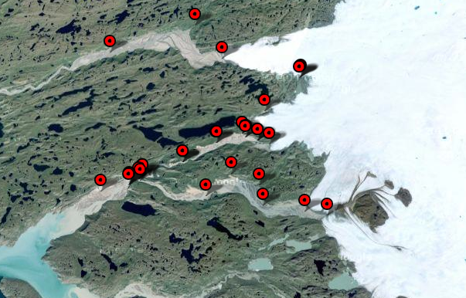
Field Work - Kangerlussuaq

Slide 11
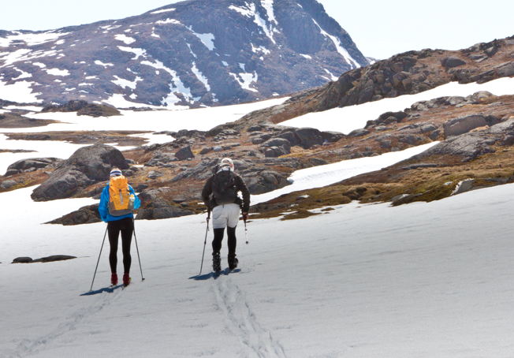
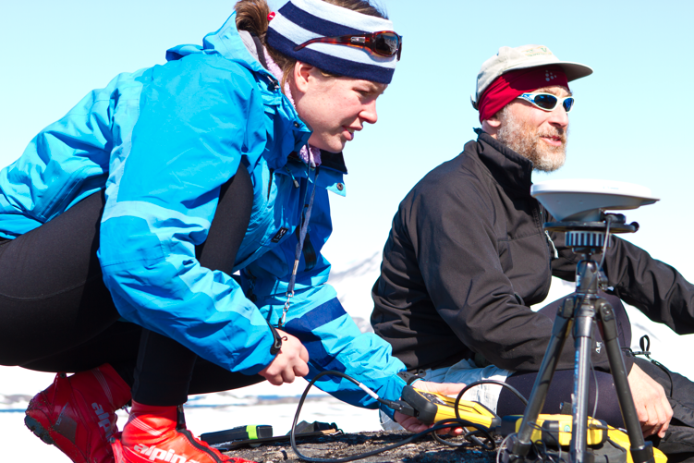
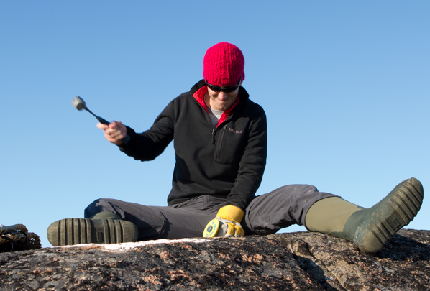
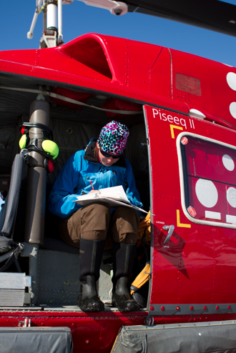
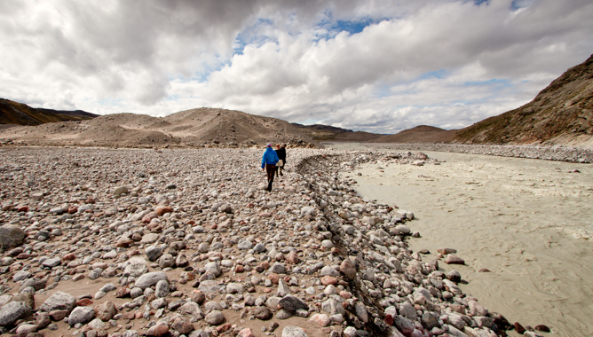
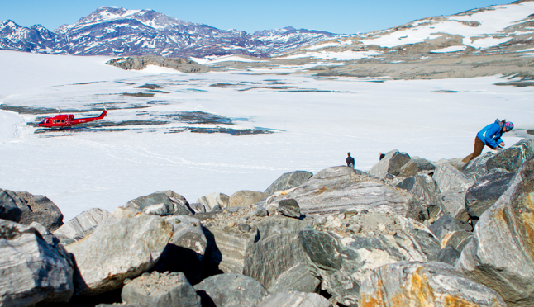
Field Work
Getting to the sample sites
Collecting elevation data
Sampling bedrock
Sampling moraine material
Sampling outwash
Taking field notes
Photos: Josh Brown

Slide 12
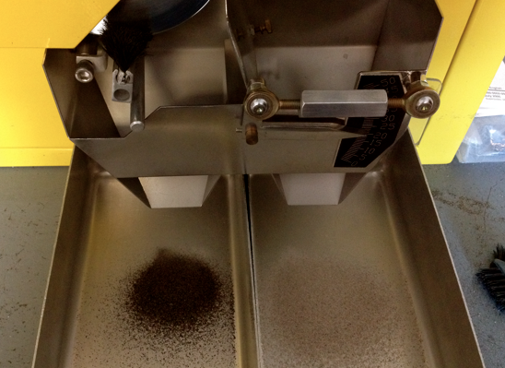
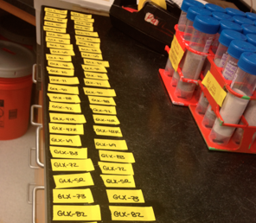
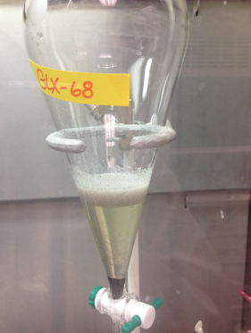
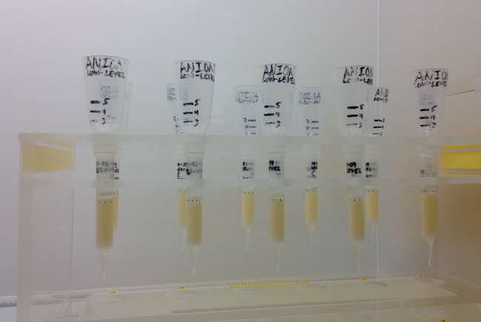
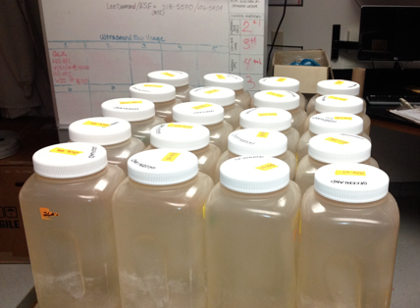
Lab Work
sieving
magnetic separation
labeling
acid etches
density separation
¹⁰Be extraction

Slide 13
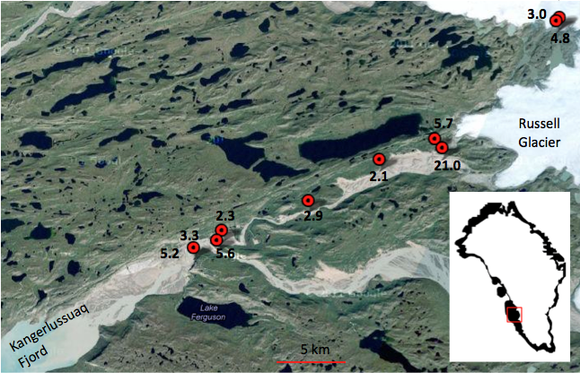
Initial Results - Kangerlussuaq

Slide 14
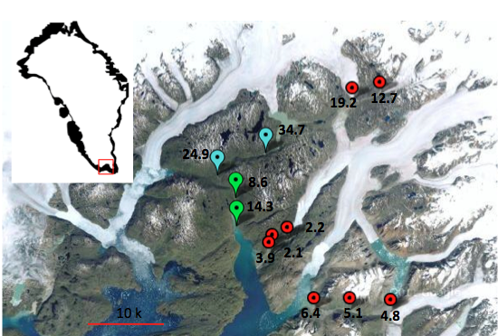
Initial Results - Narsarsuaq

Slide 15
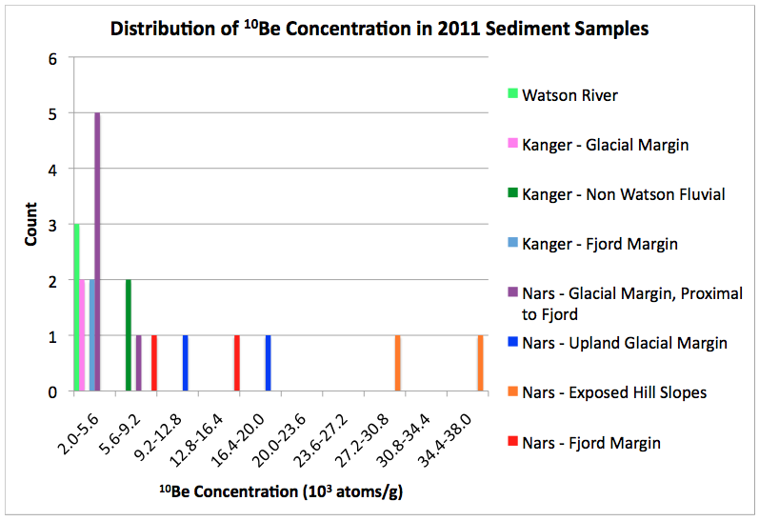
Initial Results

Slide 16
Interpretations
Sediments discharged by the GIS today contain varying concentrations of ¹⁰Be
¹⁰Be concentration in sediments eroding from exposed hill slopes is greater than ¹⁰Be concentration in sediments sourced from the ice sheet
¹⁰Be concentration in fluvial sediments increases downstream as that sediment is transported through deglaciated areas

Slide 17
To Do
 | Sample Preparation | Quartz Production | ¹⁰Be extraction | Data Acquisition
Summer 2011 65 samples | ✔ | ✔ | ✔ | ✔
Summer 2012 37 samples | ✔ | ✔ | September and October | January
ODP Site 918 30 samples | ✔ | Early October | Late October, November and Early December | January
Photo: Josh Brown

Slide 18
Timeline
October | Finish quartz production for core samples Cosmo lab processing (2 batches of field samples) Present Progress Report
November | Cosmo lab processing (2 batches of core samples) Geospatial analysis of published ¹⁰Be data Begin processing data for first batch of samples Prepare for AGU
December | Present poster at AGU Cosmo lab processing (final batch of core samples)
January | Receive, process, and begin to interpret AMS data Begin geospatial analysis
February, March | Data interpretations Create area-weighted model in GIS of ¹⁰Be concentration in sediments Work on writing
April | Work on figures and writing
May | Finish writing thesis Defend thesis

